Slide 1
Java Project to check the BMI (Body Mass Index) and BMR (Basal Metabolic rate) in Humans and Animals
Sumanth Mohan - c0752365
Abhishek Rangra - c0755154
Dhaval Kumar - c0752581
Shubham Nanda - c075900
Notes:
The Outsource Magnets

Slide 2

Introduction
BMI/BMR Checking
Animals and Humans
Database system
JDBC connection
Notes:
Software development life cycle is a system of processes and methods by which particular software is planned, designed and implemented. In this particular topic of discussion, design and implementation of specific BMI/BMR calculator are presented that takes separate values for animals and humans. In this particular program development, a choice has been provided for the participants on the type of checking that they want to do. A database system has been linked with the particular program using "JDBC" connection. Various core concepts of java have been implemented within the procedures. This particular program has been implemented without a GUI based output.

Slide 3
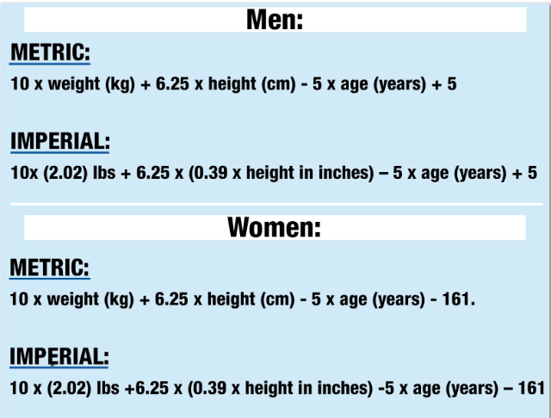
Aim and Objectives
Body Mass Index
Basal Metabolic Rate
Weight, Height and Age
Software development life cycle
Notes:
This particular project report has been documented with the purpose of serving the basic requirement analysis and implementation of core java concepts within a particular application. The BMI or Body Mass Index formula has been implemented in order to receive input from the users regarding their weight and height, calculate the specific BMI and present it as output. Another program has been separately designed within the same main class of java coding to provide an output regarding the BMR or Basal Metabolic Rate of the users. This particular program is designed to take specific weight, height, and age from users, calculate the BMR and present the result as output.
Aim and Objective of this program are to create separate methods of checking for animals and humans. Various core java concepts like inheritance, polymorphism, use of loops, etc. have been presented in this coding design and successful results are to be provided at the time of testing. A method of choosing the particulars of this procedure has been designed into the programming structure for proper ease of use. This project has been designed keeping in mind the particulars of Software Development Life Cycle and its various methodologies and concepts.

Slide 4
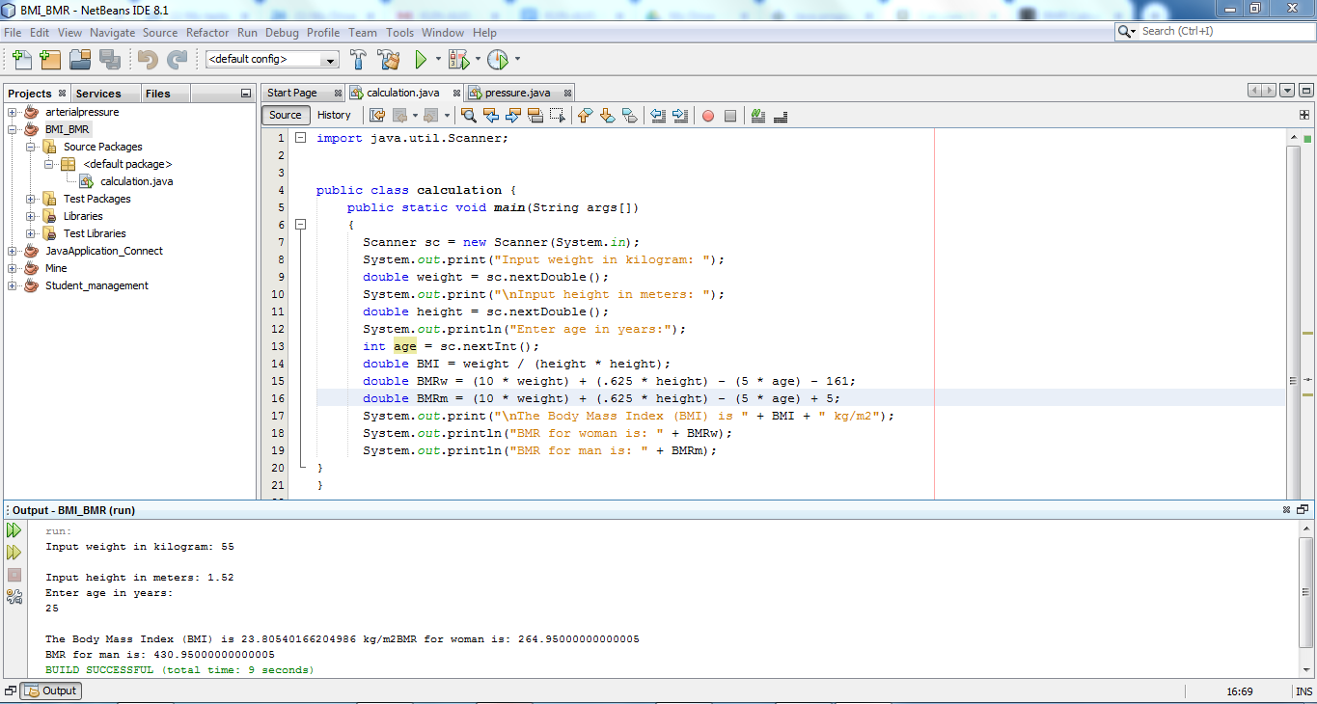
Software Development Life Cycle
SDLC models
Waterfall model
Spiral model
Planning
Requirement Analysis
Designing and implementation
Testing
Maintenance

Slide 5
Software Development life cycle is an important part of the software design and implementation. Along with the help of various SDLC models like the waterfall model or the spiral model, this particular methodology provides an overview of the various requirements of a software developer in order to create a software application for their concerned clients.. These particular steps are mentioned below:
Planning is the initial part of an SDLC. Planning requires that the development professional assess various immediate requirements for gathering of knowledge regarding the actual need for development of the software and work accordingly.
Requirement Analysis is part of SDLC where developer is required to analyze the various requirements specifically gathered for serving the exact need for software development.
We wanted to make sure that we use of all core java concepts in the coding and implementation. The core java concepts we required to get the correct results are:-
Inheritance -Classes
Polymorphism -loops
Methods -JDBC(Java Database Connectivity)

Slide 6
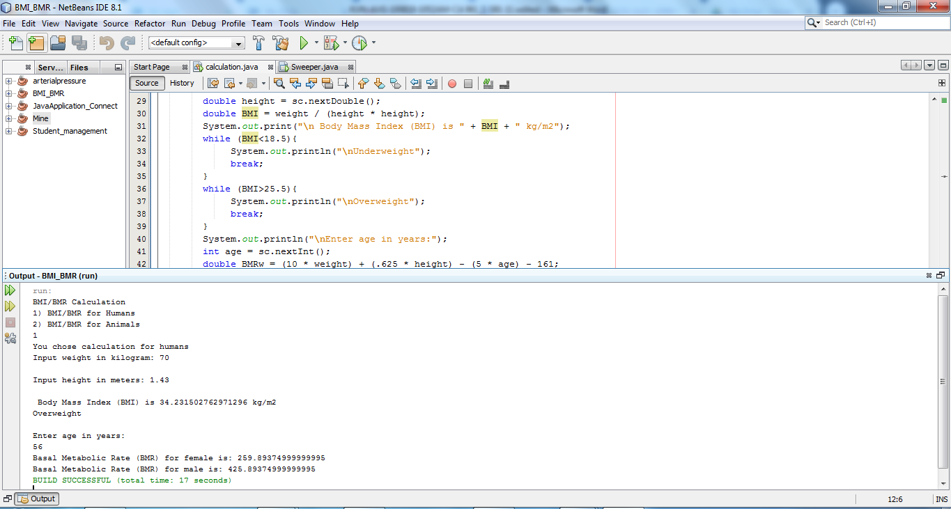
Contd…
Design and Implementation
Testing
Release and Maintenance
BMI/BMR calculation program
Notes:
Design and Implementation is the most necessary part of SDLC. This is a process where developers need to design the actual source code of the proposed software application in order to implement the various methods needed to serve specific software requirements with the help of programming languages and the use of Integrated Development Environment
Testing is the final procedure of software observation and assessment before it is released for actual use. In this particular process software application and its various functionalities are thoroughly tested for the checking of usability, efficiency, and integrity of developed application serving its purpose
Release and Maintenance is the final procedure of SDLC. This procedure witnesses the release of the actual software into the real world for practical use. In order to ensure the continuous efficiency of purpose served, developed application needs to be maintained and upgraded according to requirement
The development of these particular BMI/BMR calculation program-specific steps of SDLC has been followed for proper efficiency of the product designed.

Slide 7
Design and Implementation is the most necessary part of SDLC. This is a process where developers need to design the actual source code of the proposed software application in order to implement the various methods needed to serve specific software requirements with the help of programming languages and the use of Integrated Development Environment
Testing is the final procedure of software observation and assessment before it is released for actual use. In this particular process software application and its various functionalities are thoroughly tested for the checking of usability, efficiency, and integrity of developed application serving its purpose
Release and Maintenance is the final procedure of SDLC. This procedure witnesses the release of the actual software into the real world for practical use. In order to ensure the continuous efficiency of purpose served, developed application needs to be maintained and upgraded according to requirement
The development of these particular BMI/BMR calculation program-specific steps of SDLC has been followed for proper efficiency of the product designed.

Slide 8
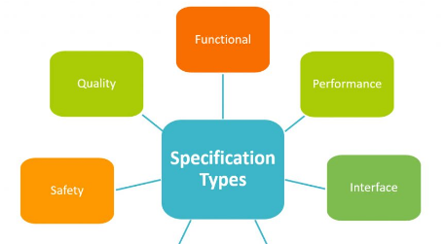
Requirement Analysis
BMR and BMI
Error message
Value less than 18.5
Value greater than 25.5
Notes:
In the application, the user can enter weight, height and age for calculating BMI and BMR. The application will accept height in meter and weight in kilogram. The program has been designed for calculating BMR and BMI of both human and animal. The user has to choose Human or Animal in starting of the program. In case of wrong selected option an error message will be displayed. As the program will check the input of user and switch to the function for finding the result for Animal or Human. If BMI will have value less than 18.5 then it will show result for Under weight and if BMI is greater than 25.5 then it will show result for overweight.
The validation of mass and body relationship required stastical analysis for the data. BSI and BMI include variation and it includes mean value for BSI. The appropriate relationship between the height and body mass is applied for scaling and it is rule for magnification of three dimensional bodies.

Slide 9
Core Java Concepts
Use of Loops
Inheritance and polymorphism
Core Java Concepts
Underweight, Overweight
Loops have been initialized
Using switch construct to view BMI/BMR

Slide 10
Code Implementation - 1
In this particular topic of discussion, the various methods of proper implementation of designed BMI/BMR checking program have been provided with specific detail to every single step involved.
For the other options, the particular core java concepts like inheritance, polymorphism, and use of loops are to be defined with In this particular menu structure, "switch case" method has been implemented for provision of various options as required by the developer to be presented to the concerned user. This particular programming will help in separately assigning databases for humans and animals

Slide 11
Code Implementation - 1
Notes:
.

Slide 12
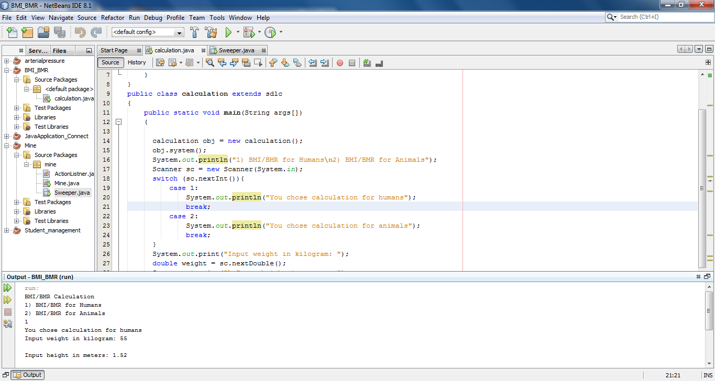
Code Implementation - 2

Slide 13
Code Implementation - 2
The provision of inheritance and polymorphism has been observed within particular coded structure according to requirement. This particular structure designed provides a proper overview of how classes can be extended and objects can be derived from other classes according to specific requirement. This particular procedure also provides two separate functions for specific values taken not more than once where required. In order to check the Body Mass Index, the values of height and weight are required as input, while in case of Basal Metabolic Rate checking, age is also required to be initialized. This program takes the three inputs only once and presented the BMI first and then with the additionally provided age input and the previously provided height and weight input calculated the BMR. Core Java concepts of inheritance and polymorphism are thus served.
In this particular screenshot, the use of loops has been provided as a reference to the specific requirements. These loops have been initialized to consider the nature of the output of specific BMI/BMR calculations provided. Specific use of loops has been done to show the statuses ‘underweight', ‘overweight' and ‘normal'.

Slide 14
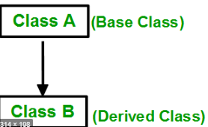
Contd..
Execution of instruction
While loop statement
Reusability
Entry control loop
Notes:
Inheritance provides a pillar for the mechanism in java that allows class for inheriting the property of parent class. the class with the feature of inheritance of class super class. Inheritance support concept for reusability and creating new class includes code that can be derived from new class. While loop statement helps in execution of the target statement and the provided condition is true. The program provides feature for facilitating the execution of instruction and function that can be used with condition is true. In While loop, the control statement for flow allows code for execution after reputation of the condition. the loop starts with checking the condition. In the loop the condition is checked, if the condition is true then the body statement can be executed further. If the statement is false then the loop will be executed. It is also called entry control loop. In this condition the valuation is true and the statement for the loop will be executed. The statement will include updated value and the variable will process for next iteration. If the statement for the condition will be false then the loop will be terminated that will mark the end for life cycle.

Slide 15
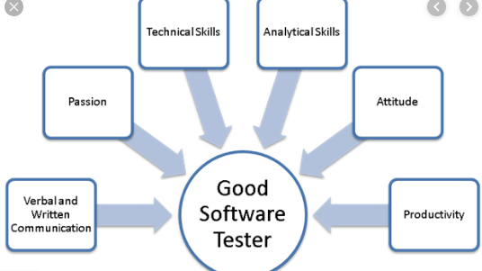
Implementation and Testing
Black box testing
White box testing
Use of graphical model
Notes:
The test plan can help in designing and provide understanding for testing and selection of type for testing. Every type of test type will have constraint and benefits. White box and black box testing can be used for the program. White box testing can run source file directly and every line of code can be tested with availability for measurement and inspection. it helps tester in resolving the failing tests with line by line step. The step for debugging also become easy for inspection and includes value for system and variables states. Black box testing is called functional testing. It works with the public interface for the service and application. Black test do not have access of interval for the artifact that are under the test. Black box testing is useful in verification for the application and development of services and system. The tester and test engineer can conduct the test for analysis and entering the input for the resulting output. The input does not have direct output and testing can help in accessing some of the aspect of system.

Slide 16
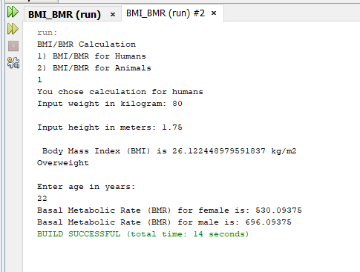
Testing – Scenario 1

Slide 17
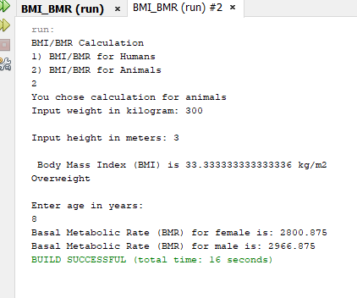
Testing – Scenario 2

Slide 18
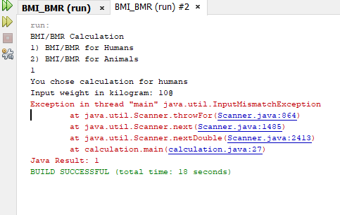
Testing – Scenario 3

Slide 19
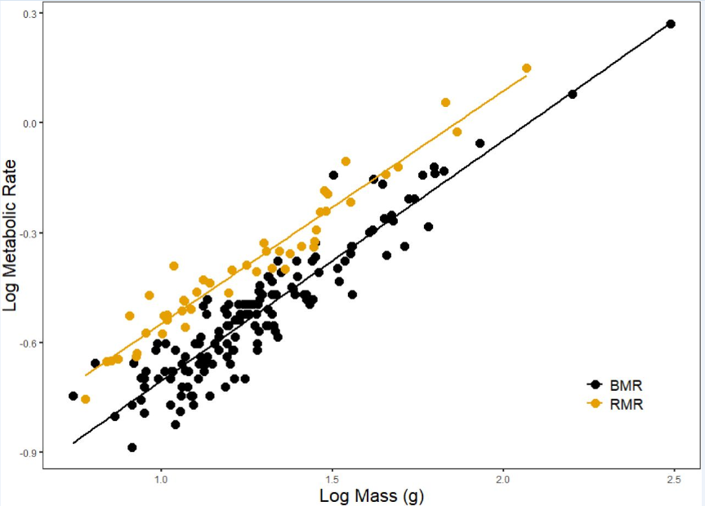
Graphical Model
Notes:
Basal metabolic rate (BMR) is often used interchangeably with resting metabolic rate (RMR). While BMR is a minimum number of calories required for basic functions at rest, RMR— also called resting energy expenditure (REE) — is the number of calories that your body burns while it's at rest.
Above graph compares the BMR and RMR for Humans.

Slide 20
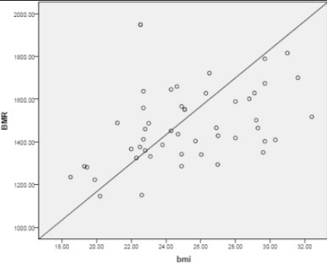
Graphical Model
Notes:
Above graph comapres the BMR vs BMI Graph for Animals

Slide 21
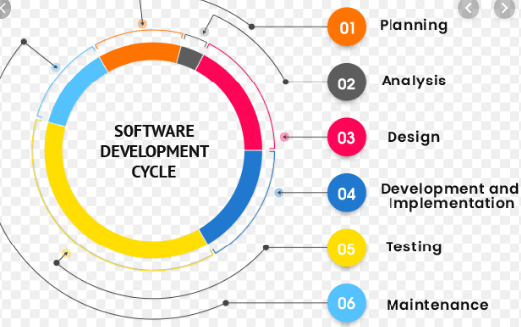
Conclusion
BMI and BMR of animal and human
Development and designing
Inheritance, loop and polymorphism
White and Black box testing
Notes:
The report includes implementation of Java codes for finding BMI and BMR of animal and human by getting value for height, weight and age. The analysis of report provides with the approach for development and designing of the code. The program has used different programming steps like inheritance, loop and polymorphism. The concepts have been used for development of program and obtaining desired results. The program can help in specifying the value that has been assigned by the user. After completion of program, testing methods like White and Black box testing has been used for ensuring that program working properly and showing desired results.

Slide 22


